Slide 1
4
INTEGRALS
Copyright © Cengage Learning. All rights reserved.

Slide 2
4.8
Integration of Rational Functions by Partial Fractions
Copyright © Cengage Learning. All rights reserved.

Slide 3
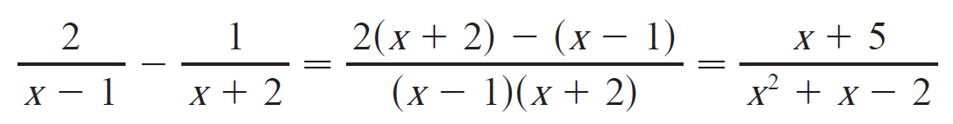
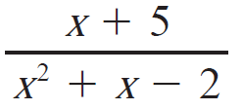
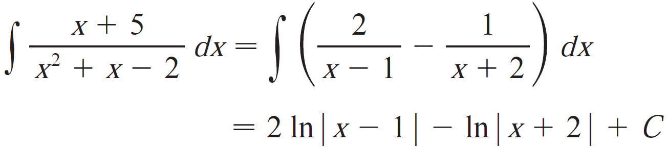
Partial Fractions
In this section we show how to integrate any rational function (a ratio of polynomials) by expressing it as a sum of simpler fractions, called partial fractions, that we already
know how to integrate.
To illustrate the idea of this method, observe
When doing integration of the rational function , we need to reverse the above procedure,

Slide 4
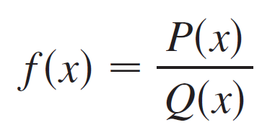
Partial Fractions
To see how the method of partial fractions works in general, let’s consider a rational function
where P and Q are polynomials.
It’s possible to express f as a sum of simpler fractions
provided that the degree of P is less than the degree of Q.
Such a rational function is called proper.

Slide 5
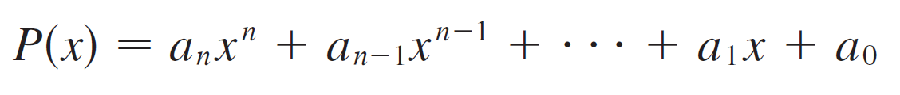
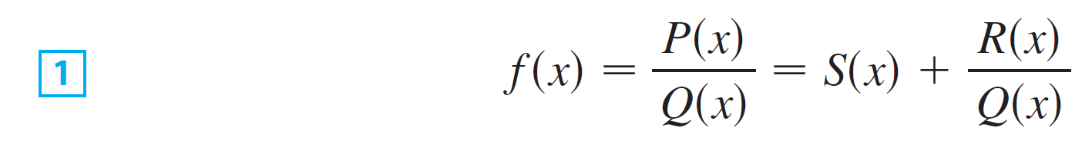
Partial Fractions
We have known that if
where a_{n} ≠ 0, then the degree of P is n, denoted as deg(P) = n.
If f is improper, that is, deg(P) ≥ deg(Q), then we must take the preliminary step of dividing Q into P (by long division) until a remainder R(x) is obtained such that deg(R) < deg(Q).
The division statement is
where S and R are also polynomials.

Slide 6
Partial Fractions
The next step is to factor the denominator Q(x) as far as possible.
It can be shown that any polynomial Q can be factored as a product of
linear factors (of the form ax + b)
and
irreducible quadratic factors
(of the form ax² + bx + c, where b² – 4ac < 0).

Slide 7
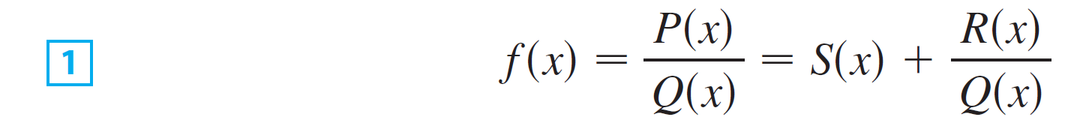
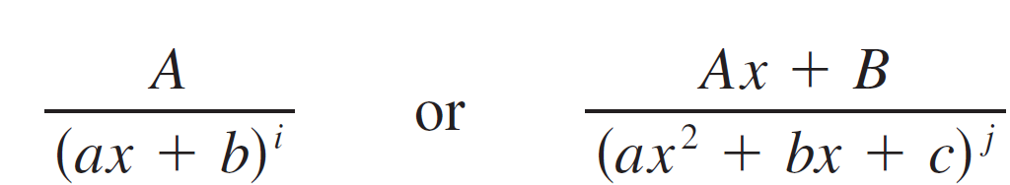
Partial Fractions
The third step is to express the proper rational function R(x)/Q(x) (from Equation 1)
as a sum of partial fractions of the form

Slide 8
Partial Fractions
A theorem in algebra guarantees that it is always possible to do this. We explain the details for the four cases that occur.
CASE I The denominator Q(x) is a product of distinct
linear factors.
This means that we can write
where no factor is repeated (and no factor is a constant multiple of another).

Slide 9
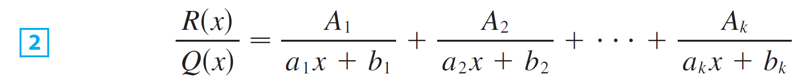
Partial Fractions
In this case the partial fraction theorem states that there exist constants A₁, A₂, …, A_{k} such that

Slide 10
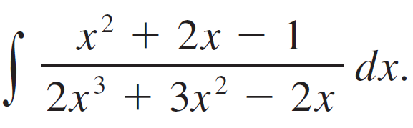
Example 2
Evaluate
Solution:
Since the degree of the numerator is less than the degree of the denominator, we don’t need to divide.
We factor the denominator as

Slide 11

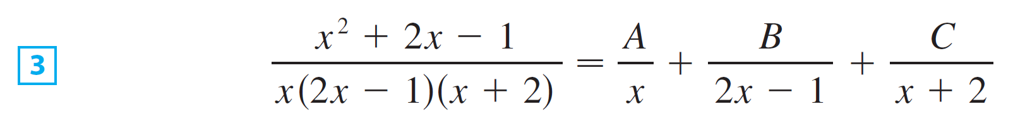

Example 2 – Solution
cont’d
Since the denominator has three distinct linear factors, the partial fraction decomposition of the integrand has the form
To determine the values of A, B, and C, we multiply both sides of this equation by the product of the denominators,
obtaining

Slide 12
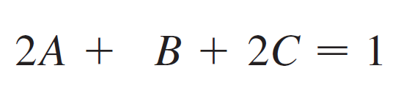
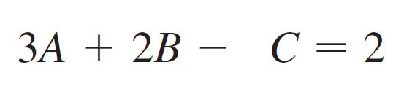

Example 2 – Solution
cont’d
Expanding the right side of Equation 4 and writing it in the standard form for polynomials, we get
The polynomials in Equation 5 are identical, so their coefficients must be equal.

Slide 13

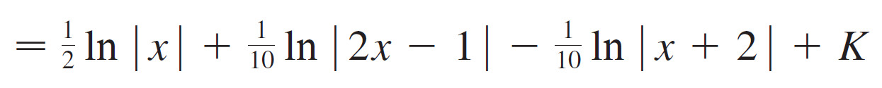
Example 2 – Solution
cont’d
Solving, we get and so
In integrating the middle term we have made the mental substitution u = 2x – 1, which gives

Slide 14
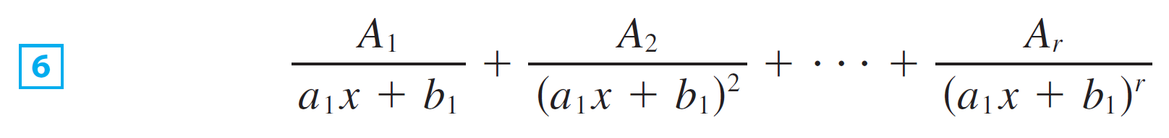
Partial Fractions
CASE II Q(x) is a product of linear factors, some of
which are repeated.
Suppose the first linear factor (a₁x + b₁) is repeated r times; that is, (a₁x + b₁)^{r} occurs in the factorization of Q(x).
Then instead of the single term A₁/(a₁x + b₁) in Equation 2, we would use

Slide 15
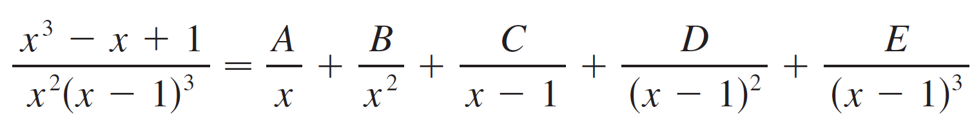
Partial Fractions
By way of illustration, we could write

Slide 16
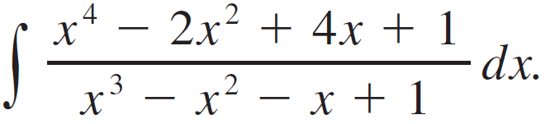
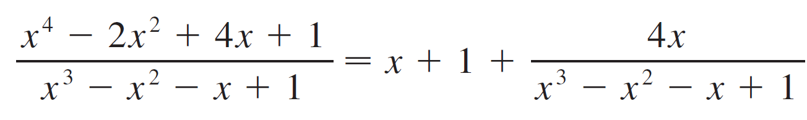

Example 3
Find
Solution:
The first step is to divide. The result of long division is
The second step is to factor the denominator

Slide 17

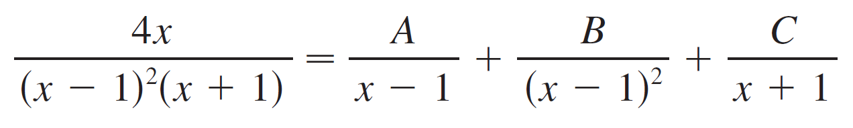
Example 3 – Solution
cont’d
Since Q(1) = 0, we know that x – 1 is a factor and we obtain
Since the linear factor x – 1 occurs twice, the partial fraction decomposition is

Slide 18
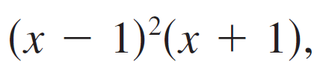
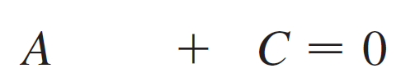


Example 3 – Solution
cont’d
Multiplying by the least common denominator, we get
Now we equate coefficients:

Slide 19
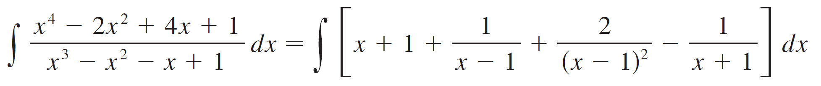
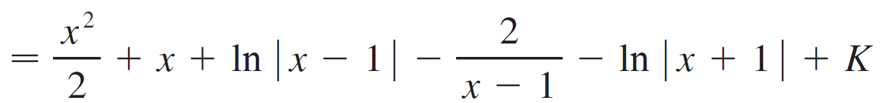
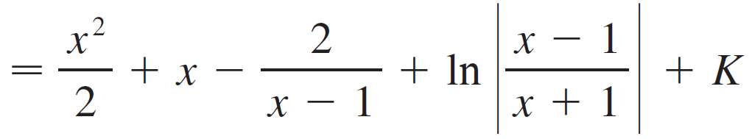
Example 3 – Solution
cont’d
Solving, we obtain A = 1, B = 2, and C = –1, so

Slide 20
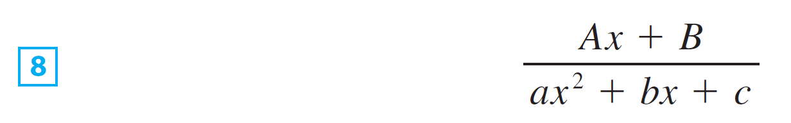
Partial Fractions
CASE III Q(x) contains irreducible quadratic factors,
none of which is repeated.
If Q(x) has the factor ax² + bx + c, where b² – 4ac < 0, then, in addition to the partial fractions in Equations 2 and 6, the expression for R(x)/Q(x) will have a term of the form
where A and B are constants to be determined.

Slide 21
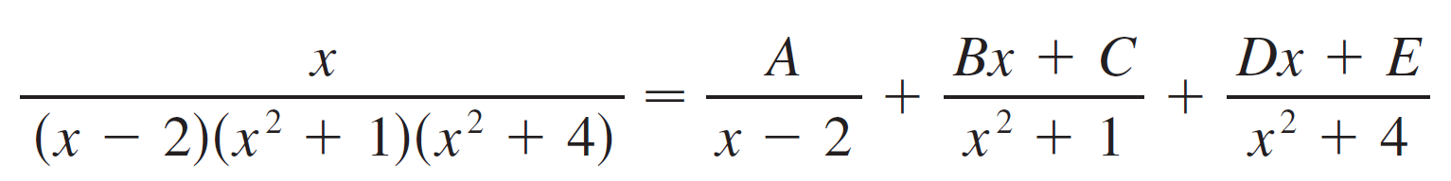

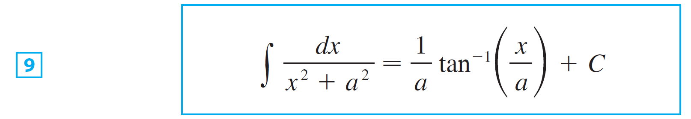
Partial Fractions
For instance, the function given by f (x) = x/[(x – 2)(x² + 1)(x² + 4)] has a partial fraction decomposition of the form
The term in can be integrated by completing the square (if necessary) and using the formula

Slide 22
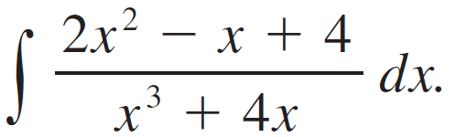

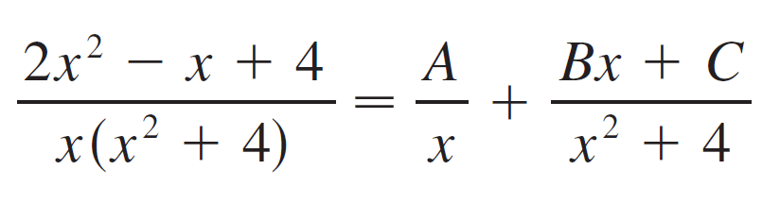
Example 4
Evaluate
Solution:
Since can’t be factored further, we write

Slide 23

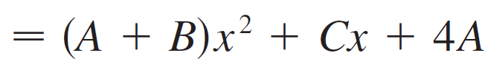
Example 4 – Solution
cont’d
Multiplying by we have
Equating coefficients, we obtain

Slide 24
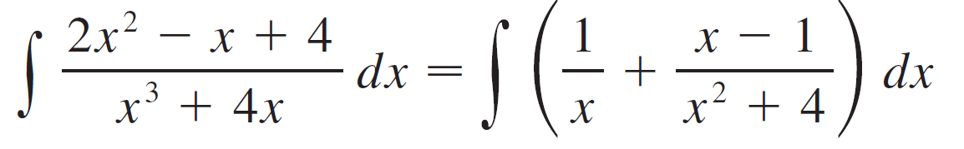
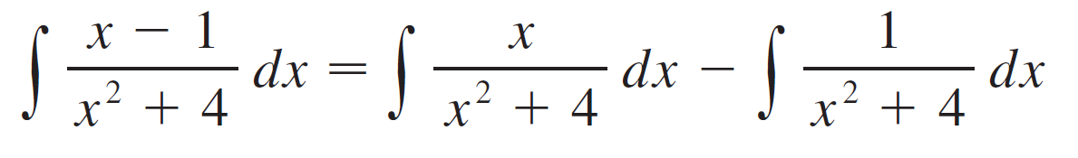
Example 4 – Solution
cont’d
Thus A = 1, B = 1, and C = –1 and so
In order to integrate the second term we split it into two parts:

Slide 25
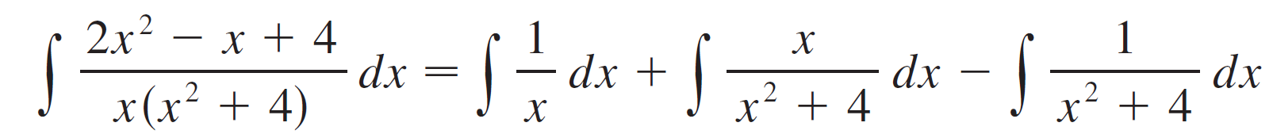
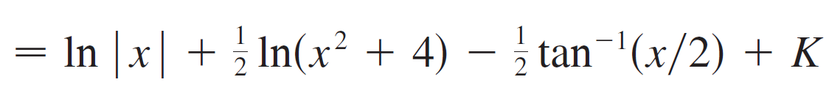
Example 4 – Solution
cont’d
We make the substitution u = x² + 4 in the first of these integrals so that du = 2x dx.
We evaluate the second integral by means of Formula 9 with a = 2:

Slide 26

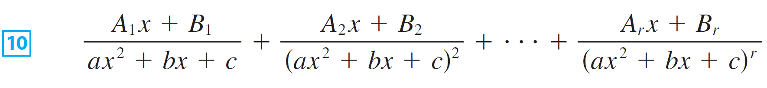


Partial Fractions
CASE IV Q(x) contains a repeated irreducible quadratic
factor.
If Q(x) has the factor (ax² + bx + c)^{r}, where b² – 4ac < 0
then instead of the single partial fraction the sum
occurs in the partial fraction decomposition of .
Each of the terms in can be integrated by completing the square and using a substitution (if necessary).

Slide 27
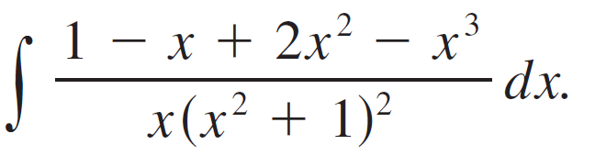
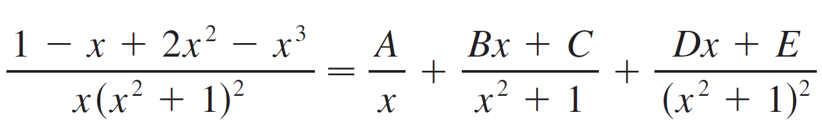
Example 7
Evaluate
Solution:
The form of the partial fraction decomposition is

Slide 28

Example 7 – Solution
cont’d
Multiplying by we have

Slide 29
Example 7 – Solution
cont’d
If we equate coefficients, we get the system
which has the solution

Slide 30
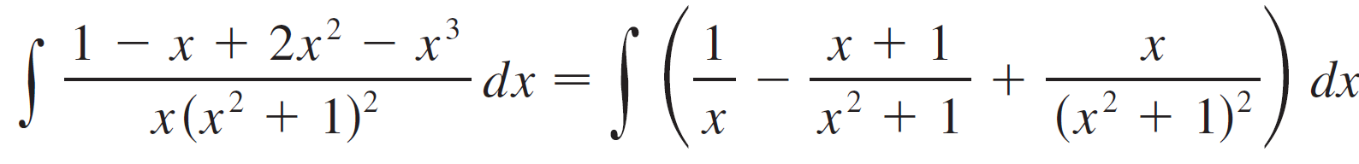
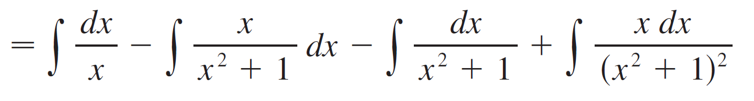
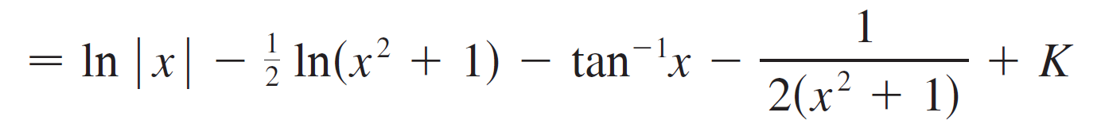
Example 7 – Solution
cont’d
Thus

